Slide 1


Detecting Citation Anomalies in Hyperbolic Space with the Poincaré Ball Model
Tomer Ben Lolo 318318987
Yotam Gilad 315819599
Project number 25-1-R-3
Supervisor:
Dvora Toledano-Kitai

Slide 2

Problem Definition
Scientific articles build upon one another by leveraging existing information and data.
To acknowledge their sources, researchers cite earlier studies.
Over time, citation patterns vary—some articles experience a surge in citations shortly after publication, only to decline in relevance, while others receive little attention initially but gain recognition and citations after a significant delay.
This project aims to identify such citation anomalies over time, specifically detecting:
Articles that peak in citations soon after publication but are later forgotten.
Articles that gain prominence only after a long period, experiencing a delayed citation peak.

Slide 3

Citation Networks
A Citation network is typically modeled as a complex graph where:
Nodes represents academic papers.
Edges represents citations between papers.
Since new research papers are published continuously, the graph evolves over time, making it dynamic
Dynamic networks provide a framework for capturing the temporal evolution of relationships by modeling how connections form, dissolve, or change over time.
In citation analysis, dynamic networks play a crucial role in tracking research trends, identifying emerging fields, and detecting citation anomalies that occur within specific timeframe.

Slide 4
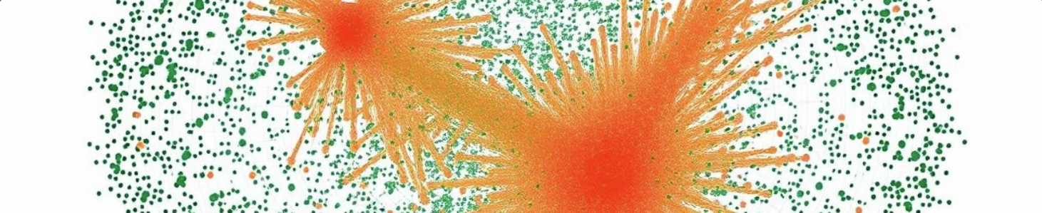
Current Landscape and Need for the Project
Importance of Citations
Challenges with Anomalies
Growing Need for Automation
Citations are essential to scientific discourse, offering context, credibility, and proper attribution for research findings.
Citation anomalies, such as misrepresentation, omission, and contextual issues, undermine the reliability and accuracy of scientific literature.
The increasing volume of scientific publications necessitates automated methods for detecting citation anomalies and preserving the integrity of scientific discourse.

Slide 5

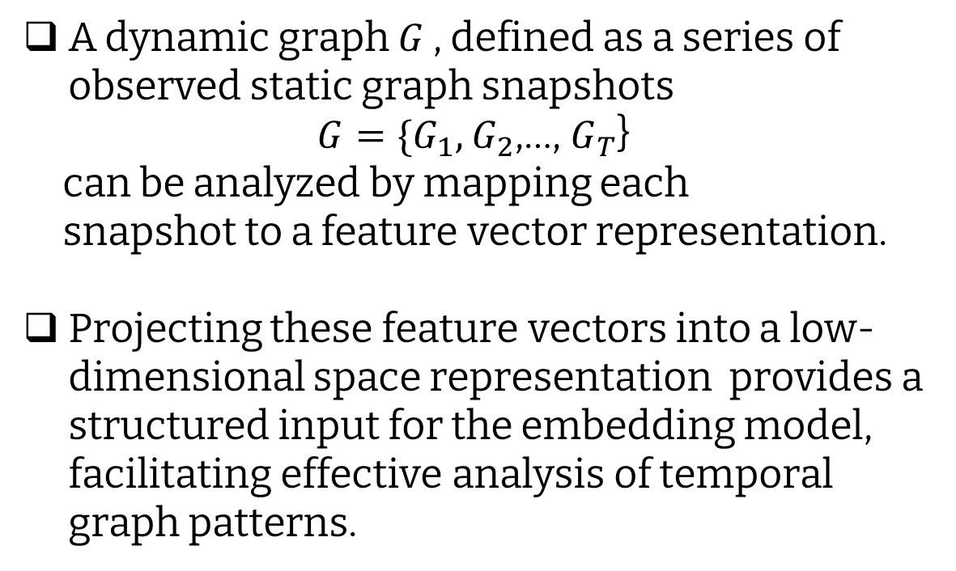
Analyzing Complex Dynamic Networks
A dynamic graph $G$ , defined as a series of observed static graph snapshots
$G=\{G_{1},$ $G_{2}$,…, $G_{T}$}
can be analyzed by mapping each
snapshot to a feature vector representation.
Projecting these feature vectors into a low-dimensional space representation provides a structured input for the embedding model, facilitating effective analysis of temporal graph patterns.

Slide 6
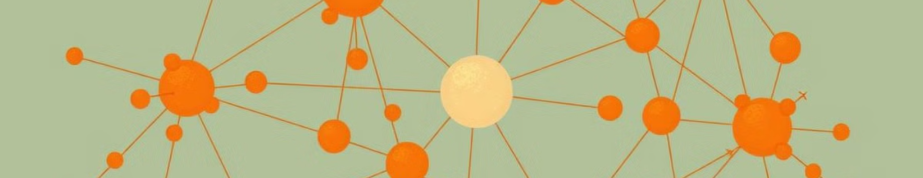
Euclidean Embedding: Benefits and Limitations
Benefits
Limitations
Simple, well-understood, efficient to compute.
Suitable for polynomial expanding graphs.
Struggle to capture hierarchical and scale-free network structures.
Poor Representation of Scale-Free Networks.

Slide 7

Hyperbolic Embedding: A Powerful Alternative
Hierarchical Structures
Scale-Free Networks
Natural representation of hierarchical relationships between nodes.
Captures power-law degree distributions, common in real-world networks.
Adaptability to Dynamic Networks
Efficient Representations
Requires less space and computational resources compared to Euclidean models.
Well-suited for complex dynamic networks with an exponential expansion model, enabling efficient representation and analysis of evolving structures.

Slide 8
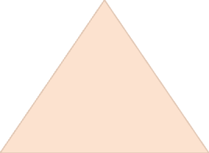
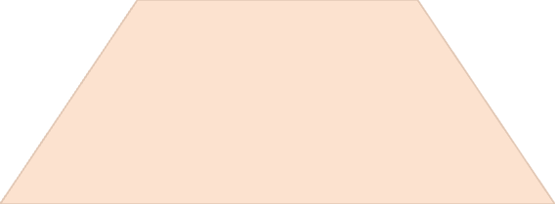

Modeling Citations in Hyperbolic Geometry
Hyperbolic Space
1
Hyperbolic geometry provides a richer representation of citation networks than Euclidean space.
Poincaré Ball Model
2
The Poincaré ball model is used to visualize and analyze hyperbolic spaces, allowing for a more intuitive understanding of citation relationships.
Citation as Points
3
Citations are represented as points within the hyperbolic space, capturing their relationships and interconnections.

Slide 9
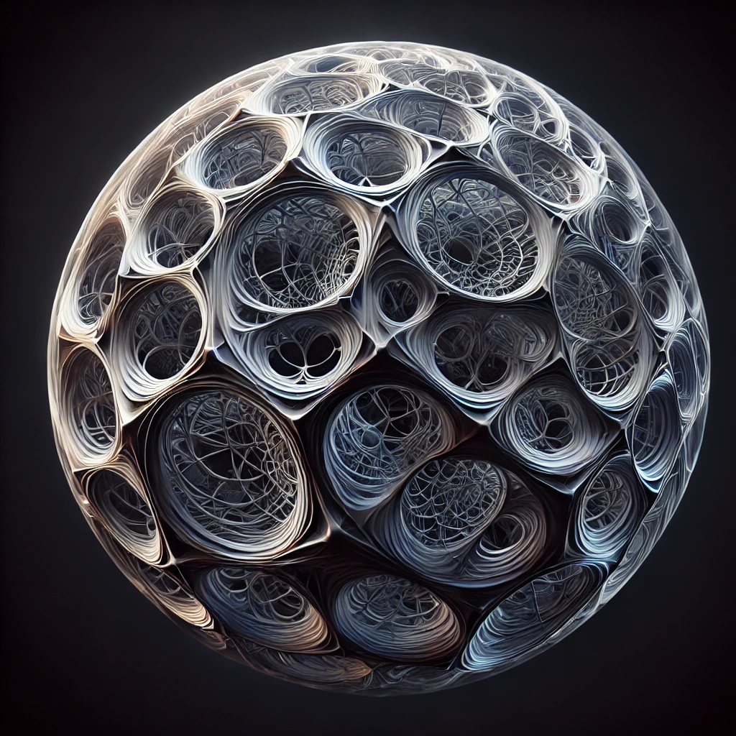
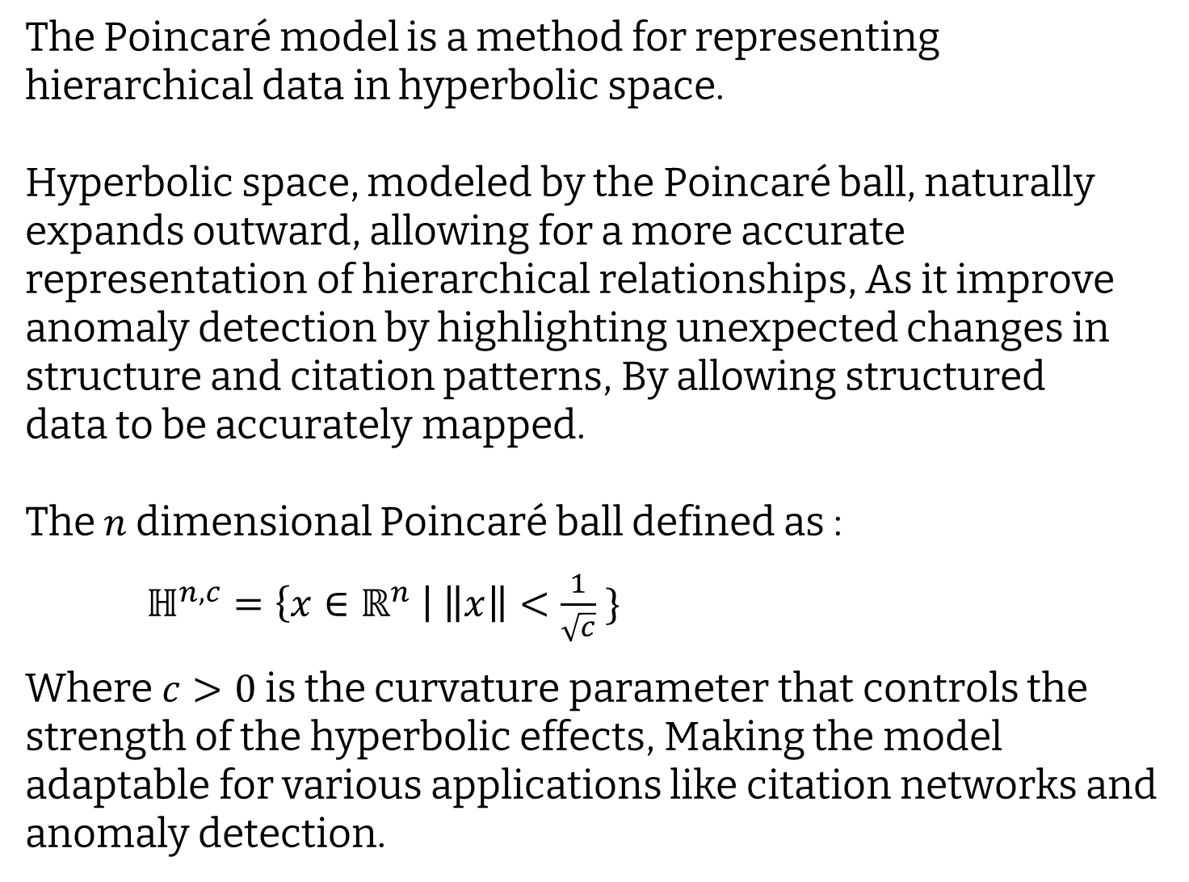
Poincaré ball model
The Poincaré model is a method for representing hierarchical data in hyperbolic space.
Hyperbolic space, modeled by the Poincaré ball, naturally expands outward, allowing for a more accurate representation of hierarchical relationships, As it improve anomaly detection by highlighting unexpected changes in structure and citation patterns, By allowing structured
data to be accurately mapped.
The $n$dimensional Poincaré ball defined as :
$ℍ^{n,c}=\left\{x∈ℝ^{n} \right| \left\|x\right\|<\frac{1}{\sqrt{c}} \}$
Where $c>0$is the curvature parameter that controls the strength of the hyperbolic effects, Making the model adaptable for various applications like citation networks and anomaly detection.

Slide 10
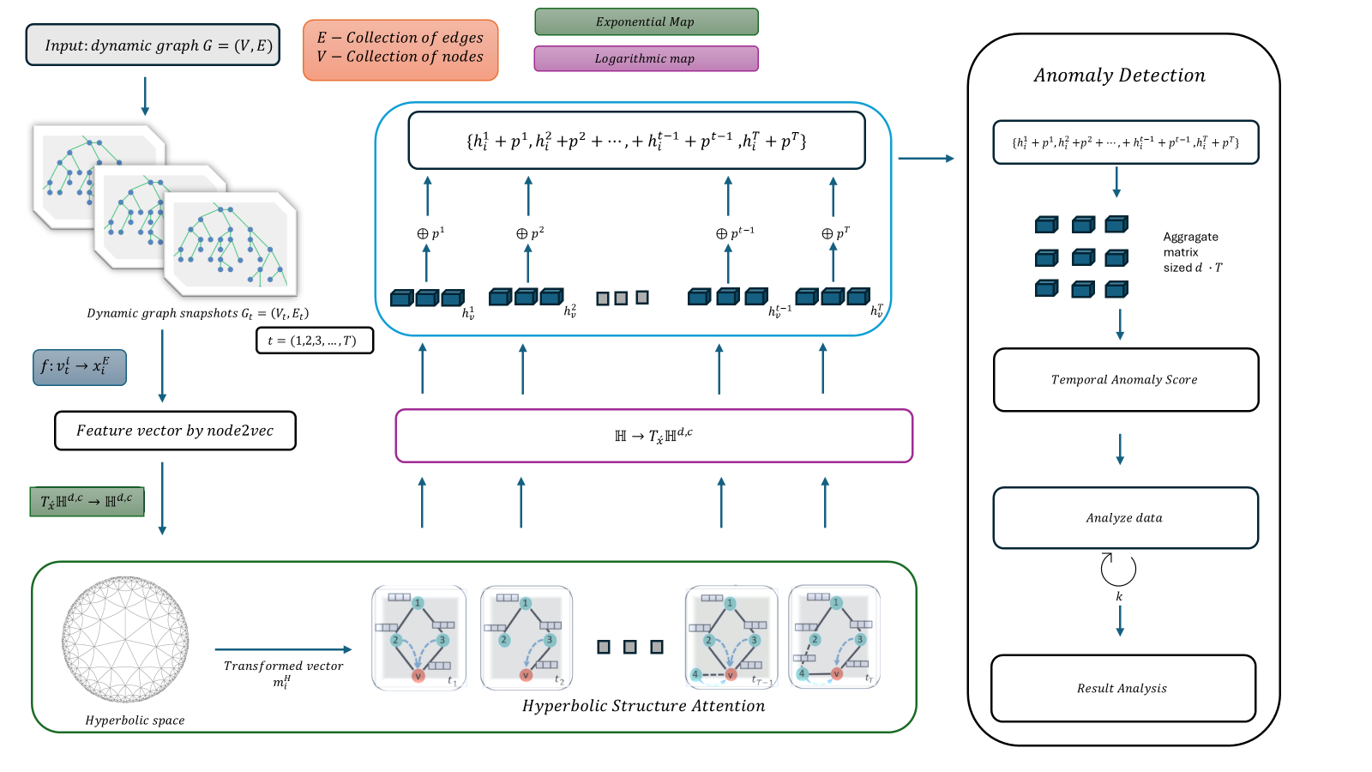
Proposed Framework for Our Model
Hyperbolic Structural Attention(HSA)
Anomaly Detection
1
3
2
Position Embedding

Slide 11

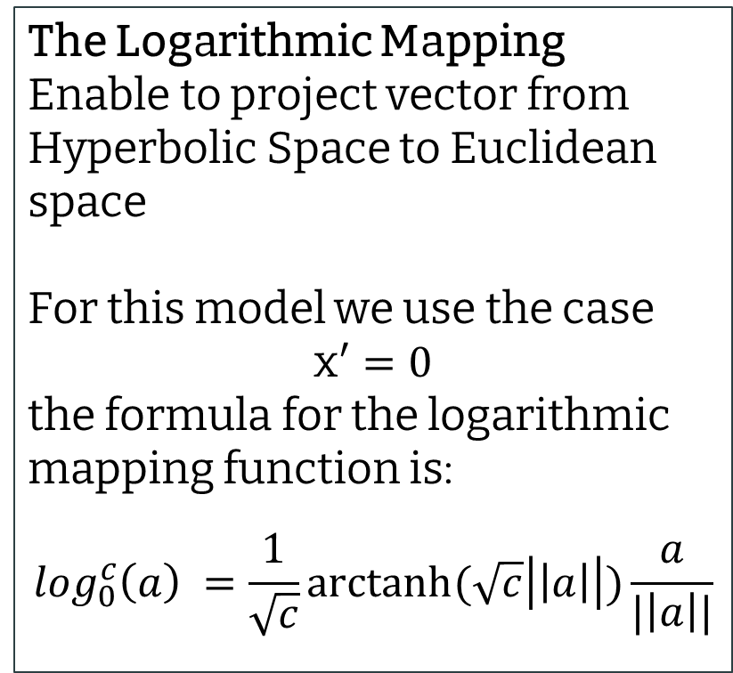
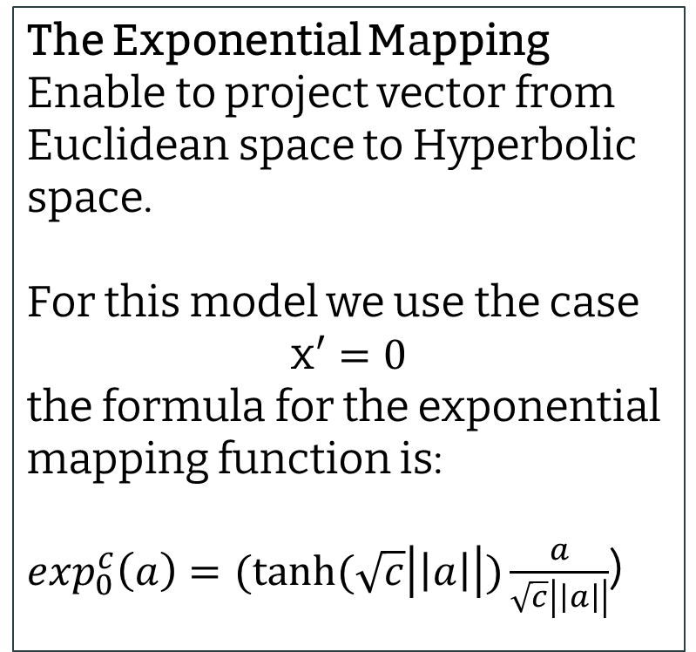
Exponential and Logarithmic Mapping
The Exponential Mapping Enable to project vector from Euclidean space to Hyperbolic space.
For this model we use the case
x$′=0$
the formula for the exponential mapping function is:
$\exp_{0}^{c}\left(a\right)=(tanh⁡(\sqrt{c}\left|\left|a\right|\right|)\frac{a}{\sqrt{c}\left|\left|a\right|\right|}$)
The Logarithmic Mapping
Enable to project vector from Hyperbolic Space to Euclidean space
For this model we use the case
x$′=0$
the formula for the logarithmic mapping function is:
$$\log_{0}^{c}\left(a\right) =\frac{1}{\sqrt{c}}arctanh⁡(\sqrt{c}\left|\left|a\right|\right|)\frac{a}{|\left|a\right||}$$
These mapping function used in our project to move between the Euclidean space and the Hyperbolic space while preserve the vectors information.

Slide 12

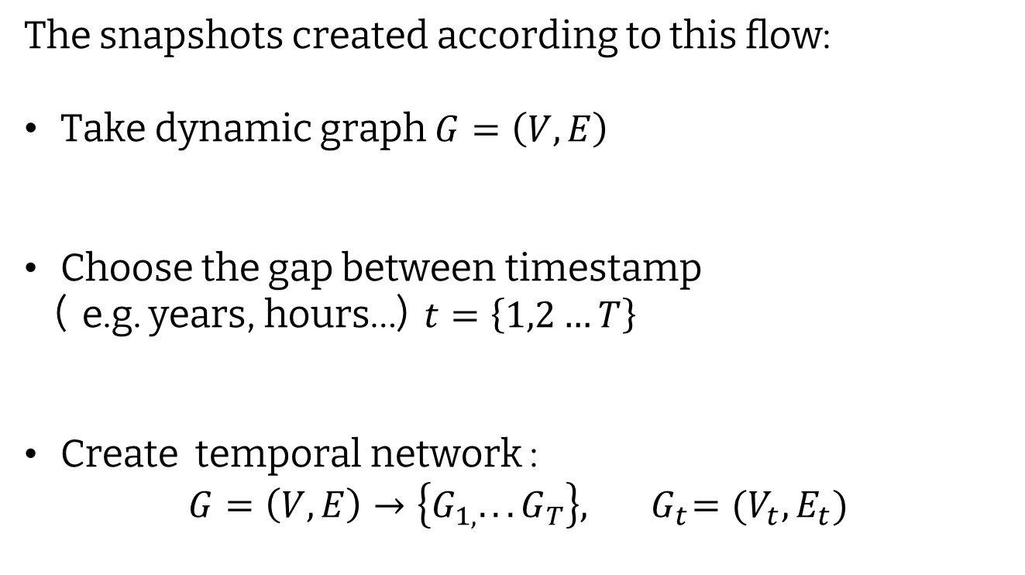
Snapshots Model
The snapshots of dynamic graph aim to capture the changes over timestamp in a temporal network.
The snapshots created according to this flow:
Take dynamic graph $G=\left(V,E\right)$
Choose the gap between timestamp
( e.g. years, hours…) $t=\left\{1,2…T\right\}$
Create temporal network :
$$G=\left(V,E\right)→\left\{G_{1,}. . . G_{T}\right\},{ G}_{t}=(V_{t},E_{t})$$

Slide 13
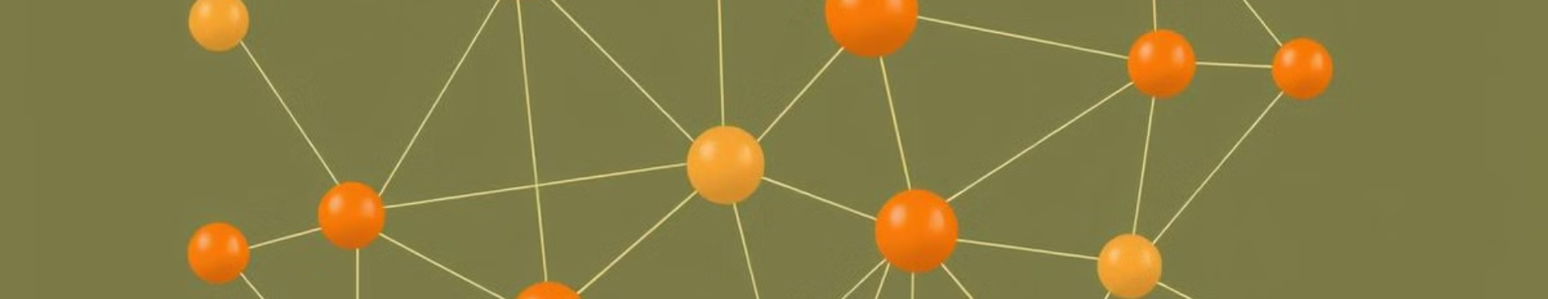



Hyperbolic Structural Attention (HSA)
Graph Structure
Hyperbolic Embedding
Attention Mechanism
Leverages the graph's structure to learn relationships between nodes.
Uses hyperbolic embedding to represent nodes and their distances.
Focuses on relevant nodes and their relationships, highlighting key connections.

Slide 14
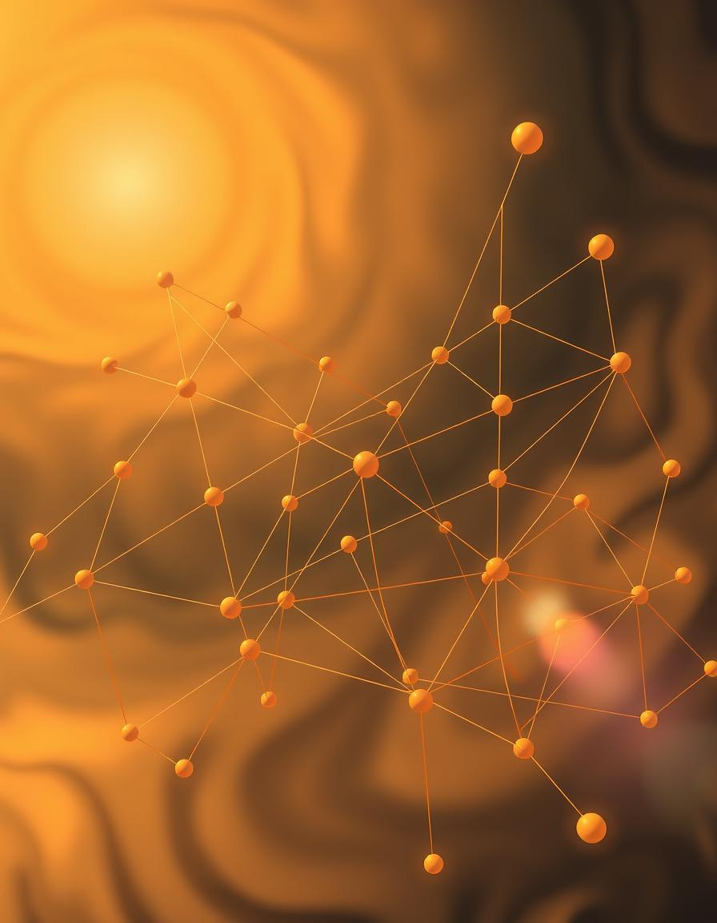
Position Embedding
The model's lack of awareness of sequential order in dynamic graphs is addressed by embedding positional information into node representations. This allows the model to distinguish between different positions in a sequence.
This temporal ordering enables the model to understand the position of each node throughout the timeline.

Slide 15

Anomaly Detection in Hyperbolic Space
1
2
3
Outliers
Unexpected Connections
Unusual Patterns
Nodes that are significantly far from other nodes in hyperbolic space. Using Isolation Forest, we can efficiently detect such outliers by isolating them through recursive partitioning.
Relationships between nodes that are not expected based on their hyperbolic distances.
Detects anomalous patterns in the network's structure and relationships.

Slide 16
Analysis & Training Phase
Based on the dataset characteristics, one of the following training and detection tools will be selected:
For further examination of the anomaly scores,
This methods are suggested:
Statistical Analysis
Scikit-Learn
Identification of Extreme Cases
H2O.ai
Normalization
PySpark
Visualization

Slide 17
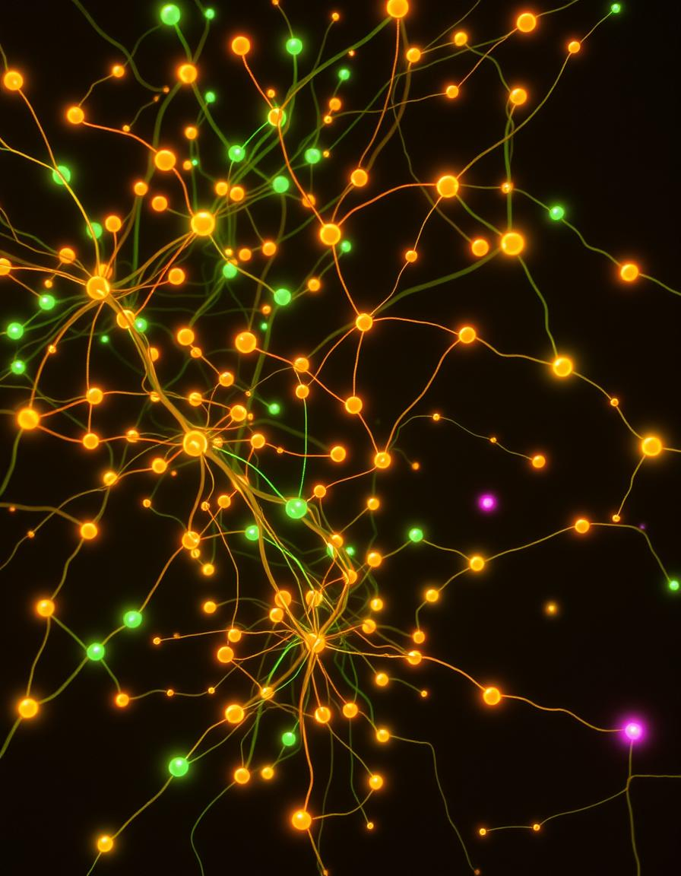


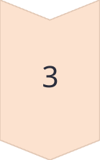
Validation Phase
creating a controlled laboratory environment to assess sensitivity to structural changes.
Inject Random Nodes
Add isolated or connected nodes to disrupt the network's inherent structure, generating unexpected anomalies.
Assess Performance
Evaluate how the model responds to these structural disruptions, measuring its adaptability and resilience.
Analyze Results
Ensure that the process is performed through multiple iterations and conduct a comparative analysis relative to the temporal anomaly results across all iterations.

Slide 18

Expected Results
This model aims to achieve robust and precise anomaly detection in dynamic citation networks. We expect the model to effectively analyze and interpret these networks for anomaly detection. The model integrates hyperbolic geometry, self-attention mechanisms, and temporal embedding to advance graph-based anomaly detection methodologies.
The proposed model is expected to achieve at least 80% detection rate for anomalies within dynamic citation graphs.

Slide 19

Expected Challenges
Several challenges are anticipated in the implementation of this project, Each plays a crucial role in ensuring the accuracy and efficiency of the proposed model.
Dataset Selection
Computational Constraints
Parameter Optimization
Through an iterative process of trial and error, we aim to refine and adjust these configurations to ensure the development of a robust and reliable model capable of effectively detecting citation anomalies.

Slide 20

Thank you for listening.
Questions?

